Slide 1
Software Engineering Software Architecture Continued
CS 1530
Spring 2020
Instructor: Sohel Sarwar
University of Pittsburgh
Lecture 8

Slide 2


Architectural Patterns

Slide 3


Architectural Patterns
Multi Layered
Multi Tiered
Client-Server
Pipe & Filter
Broker
MVC
DONE

Slide 4
Architectural Patterns
Event-driven architecture
Service Oriented Architecture
Microservices

Slide 5


Service Oriented Architecture (SOA)

Slide 6

Service Oriented Architecture (SOA)
An architectural principle for structuring systems into coarse-grained services
Technology-neutral best practice
Emphasizes the loose coupling of services
New services are created from existing ones in a synergistic fashion
Strong service definitions are critical
Services can be re-composed when business requirements change

Slide 7

What Are Services?
Black-box components with well-defined interfaces
Performs some arbitrary function
Can be implemented in myriad ways
Accessed using XML message exchanges
Using well-known message exchange patterns (MEPs)
Metadata in the form of WSDL describes...
Abstract interfaces
Concrete endpoints

Slide 8

What Can Services Do?
Perform business logic
Transform data
Route messages
Query databases
Apply business policy
Handle business exceptions
Prepare information for use by a user interface
Orchestrate conversations between multiple services

Slide 9
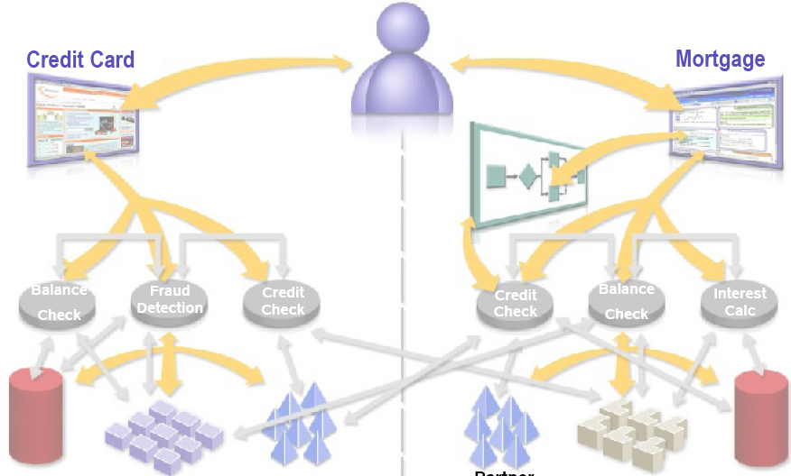
Pre-SOA Scenario
Back-
End
System
Customer
Data
Partner
Credit
Data
Partner
Credit
Data
Back-
End
System
Customer
Data

Slide 10
SOA Enabled Scenario
Partner Credit
Data
Back-End
System
Back-End
System
Customer
Data

Slide 11
SOA Layers
Shared Network-based Layered Services

Slide 12

Benefits of SOA
Flexible (Agile) IT
Adaptable to changing business needs
Faster time to market
Reuse existing code, minimize new development
Business and process-driven
New business opportunities
Greater ROI
Leverage existing IT asset

Slide 13

How Are Services Implemented?
Java Spring
C#/.NET
PHP
Node.JS
Etc…

Slide 14
How Are Services Implemented?
@WebService
public class AddNumbersImpl {
@WebMethod(action="addNumbers")
public int addNumbers(int number1, int number2)
throws AddNumbersException {
if (number1 < 0 || number2 < 0) {
throw new AddNumbersException(
"Negative number cant be added!",
"Numbers: " + number1 + ", " + number2);
}
return number1 + number2;
}
}

Slide 15

How Are Services Implemented?
WSDL stands for Web Services Description Language.
Features of WSDL
WSDL is an XML-based protocol for information exchange in decentralized and distributed environments.
WSDL definitions describe how to access a web service and what operations it will perform.
WSDL is a language for describing how to interface with XML-based services.
WSDL is an integral part of Universal Description, Discovery, and Integration (UDDI), an XML-based worldwide business registry.

Slide 16

How Are Services Implemented?
WSDL is often used in combination with SOAP and XML Schema to provide web services over the Internet. A client program connecting to a web service can read the WSDL to determine what functions are available on the server. Any special datatypes used are embedded in the WSDL file in the form of XML Schema. The client can then use SOAP to actually call one of the functions listed in the WSDL.

Slide 17
Microservices Architectural Pattern

Slide 18
MicroservicesArchitectural Pattern
A microservice is a variant of the service-oriented architecture (SOA) style that structures an application as a collection of loosely coupled services, which are fine-grained and the protocols are lightweight.

Slide 19
MicroservicesArchitectural Pattern
Microservice is a service-based application development methodology. In this methodology, big applications will be divided into smallest independent service units. Microservice is the process of implementing Service-oriented Architecture (SOA) by dividing the entire application as a collection of interconnected services, where each service will serve only one business need.

Slide 20
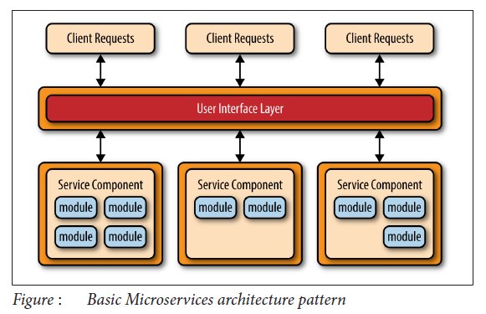
MicroservicesArchitectural Pattern

Slide 21
MicroservicesArchitectural Pattern
Benefits:
Modularity with loose coupling
Parallel Development
Continuous Development
Scalability: The distributed architecture of the services render them to be fully decoupled from one other and accessed through some sort of remote access protocol (e.g., JMS, AMQP, REST, SOAP, RMI, etc.).

Slide 22
Single Sign-On Architecture

Slide 23
Single Sign-On Architectural Pattern
Single Sign On (SSO) deals with authentication and the technical interoperability of the actors involved to provide the common login credentials across systems.

Slide 24
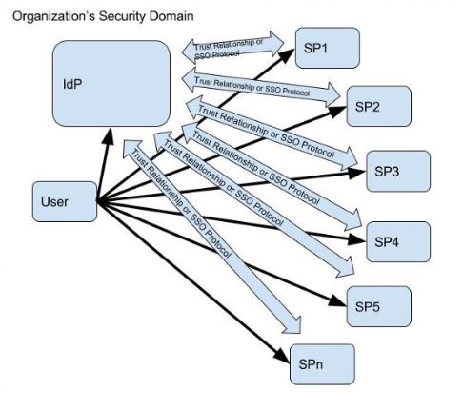
Single Sign-On Architecture

Slide 25
Event-Driven Architectural Pattern

Slide 26
Event Driven Architecture
The event-driven architecture pattern is a popular distributed asynchronous architecture pattern used to produce highly scalable applications.
It is also highly adaptable and can be used for small applications and as well as large, complex ones.
The event-driven architecture is made up of highly decoupled, single-purpose event processing components that asynchronously receive and process events.

Slide 27
Event Driven Architecture
The event-driven architecture pattern consists of two main topologies:
Mediator: The mediator topology is commonly used when you need to orchestrate multiple steps within an event through a central mediator.
Broker: The broker topology is used when you want to chain events together without the use of a central mediator.

Slide 28
Event Driven Architecture - Mediator
Mediator Topology
The mediator topology is useful for events that have multiple steps and require some level of orchestration to process the event. For example, a single event to place a stock trade might require you to:
first validate the trade,
then check the compliance of that stock trade
against various compliance rules
assign the trade to a broker
Calculate the commission
finally place the trade with that broker.
All of these steps would require some level of orchestration to determine the order of the steps and which ones can be done serially and in parallel.

Slide 29
Event Driven Architecture - Mediator
There are four main types of architecture components within the mediator topology:
event queues
an event mediator
event channels
event processors.

Slide 30
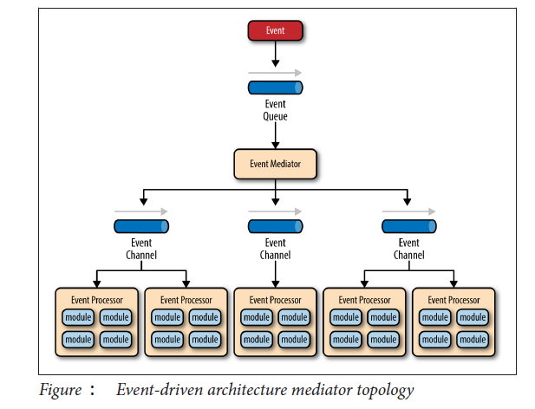
Event Driven Architecture - Mediator

Slide 31
Event Driven Architecture - Mediator
The event flow starts with:
A client sending an event to an event queue → which is used to transport the event to the event mediator → The event mediator receives the initial event and orchestrates that event by sending additional asynchronous events to event channels to execute each step of the process.
Event processors, which listen on the event channels, receive the event from the event mediator and execute specific business logic to process the event.

Slide 32
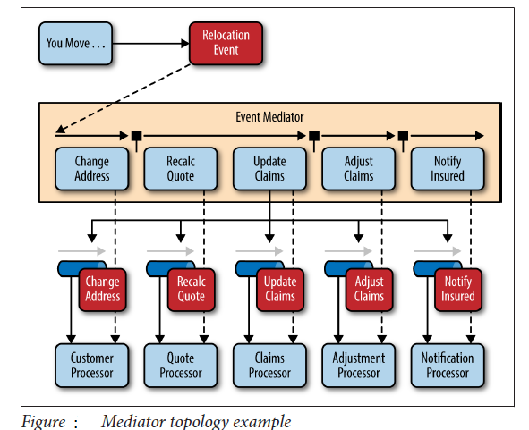
Event Driven Architecture - Mediator

Slide 33
Event Driven Architecture - Broker
Broker Topology
The broker topology differs from the mediator topology in that there is no central event mediator; rather, the message flow is distributed across the event processor components in a chain-like fashion through a lightweight message broker (e.g., ActiveMQ, HornetQ, etc.). This topology is useful when you have a relatively simple event processing flow and you do not want (or need) central event orchestration.

Slide 34
Event Driven Architecture - Broker
There are two main types of architecture components within the broker type:
broker component
event processor component.
The broker component can be centralized or federated and contains all of the event channels that are used within the event flow.
The event channels contained within the broker component can be message queues, message topics, or a combination of both.

Slide 35
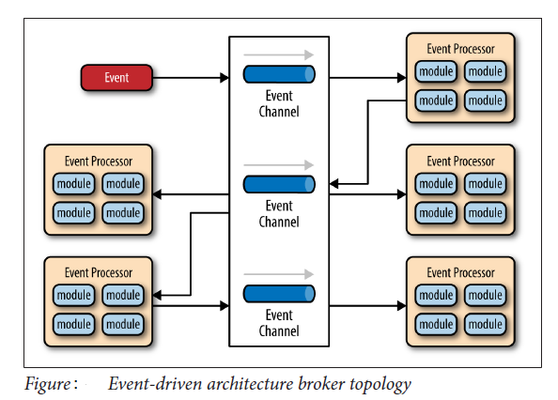
Event Driven Architecture - Broker

